Slide 1
Pediatric hiv research IN CANADA
EPIC4
CARMA
HPV-in-HIV
29-04-2017

Slide 2
Why hold a Cparg kte event?
In past 5-10 years, several large research projects have come together focusing on pediatric HIV, funded by CIHR and other funders
In past couple of years, all 3 teams have had opportunity to share results. Most of this sharing of results has been at conferences like CAHR or IAS
Sharing results with research participants in clinic is sometimes difficult, as clinic time is quickly taken up in caring for health issues
Knowledge Translation is an important activity – it lets research participants know the results and value of their contribution, and allows for feedback on priorities for future directions

Slide 3
CPARG Pediatric HIV Research KTE
Multiple activities for KTE:
Local KTE events (eg. AIDS Committee of Ottawa)
Publications in CATIE and other community-oriented sources
Project websites (eg. epic4.ca)
Informal sharing with individuals

Slide 4
Overview for today’s discussion
1. Introduction – Dr. Jason Brophy
2. Knowledge translation by CPARG – Dr. Fatima Kakkar
3. EPIC4 Study – Dr. Fatima Kakkar
4. HPV Vaccine Study – Dr. Deborah Money
6. CARMA Study – Dr. Jason Brophy
7. Community respondents
8. Open discussion

Slide 5
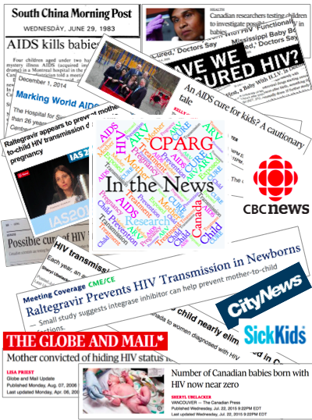
CPARG
Canadian Paediatric AIDS Research Group formed in 1992, bringing together paediatricians from across Canada with a clinical and research interest in pediatric HIV treatment and care
Rebranded in 2015 as Canadian Pediatric & Perinatal HIV/AIDS Research Group (still CPARG)
In 2017, CPARG moved decided to move into the 21st century – obtained Dissemination & Planning grant from CIHR to share resources to professionals and community via new website

Slide 7
CPARG’s Twitter account – 48 followers and counting!!!

Slide 8
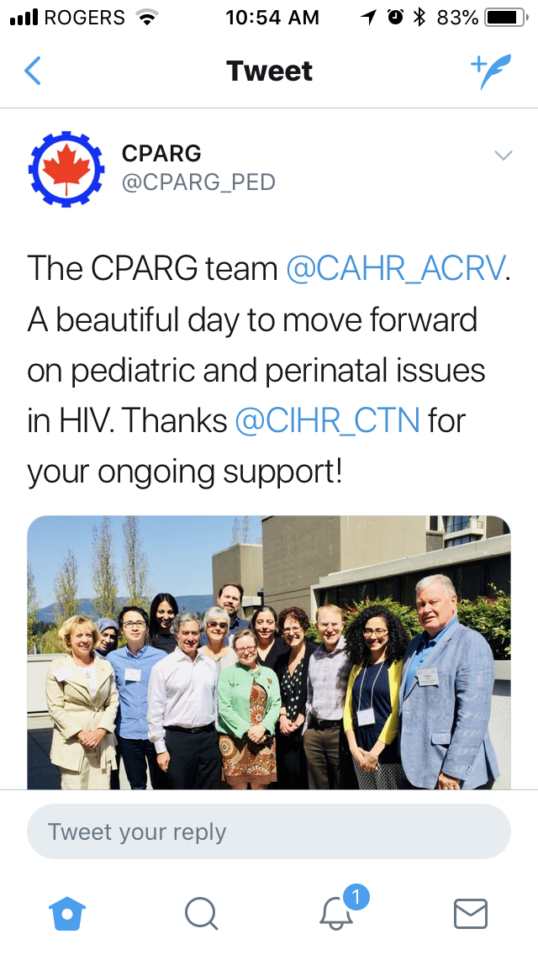
PLEASE SIGN UP TO CPARG’S TWITTER HANDLE:
@CPARG_PED
AIM FOR 100 FOLLOWERS BY END OF CAHR 2018!

Slide 9
Early Pediatric Treatment Initiation – Canada Child CURE Cohort study Dr. Fatima Kakkar

Slide 10
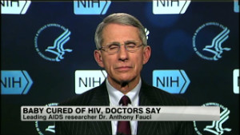
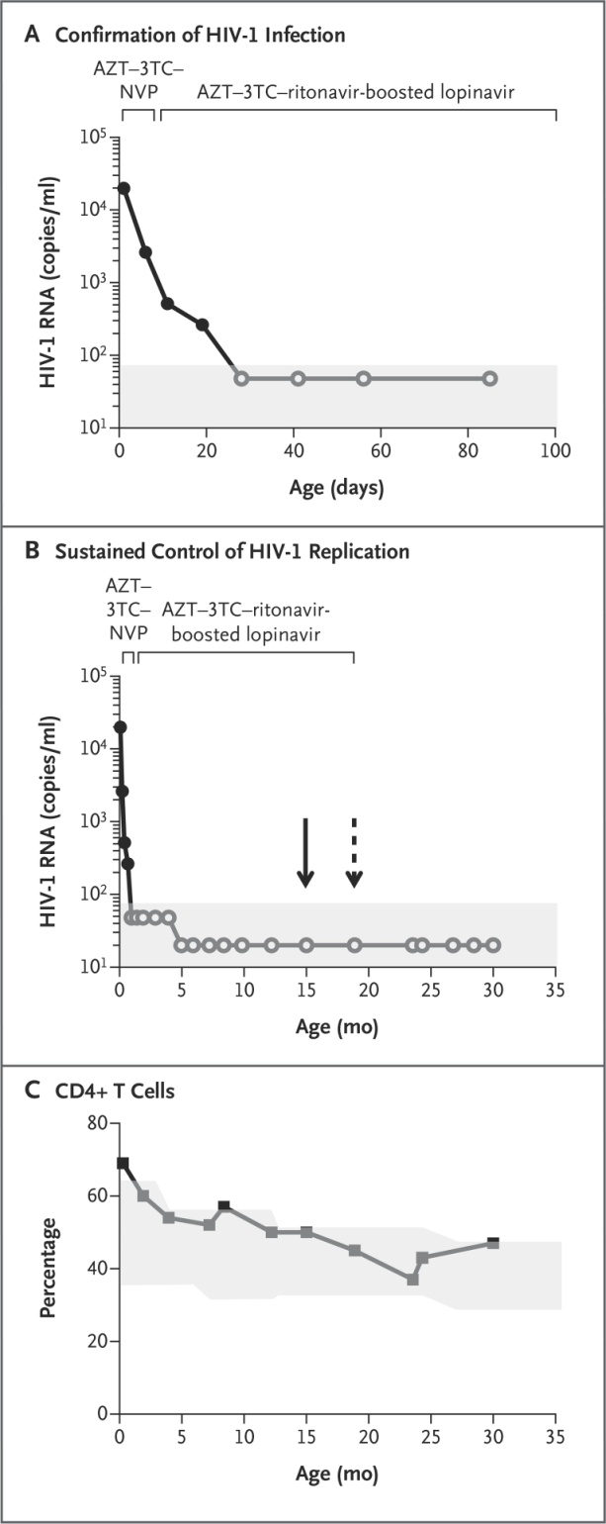
What lead to the EPIC⁴ study? The case of the mississippi baby
Mississippi baby is a child born to a mother living with HIV who was only diagnosed at the time of delivery
The baby was confirmed as also infection with HIV within 24 hours of birth
The baby started triple therapy at 30 hours of age, and quickly suppressed her HIV viral load
Baby’s treatment was stopped after 18 months of age
No sign of the virus in her blood for over 2 years without treatment
Viral load went up at 27 months after treatment stopped. Quickly restarted treatment and viral load suppressed again.
Viral remission?

Slide 11
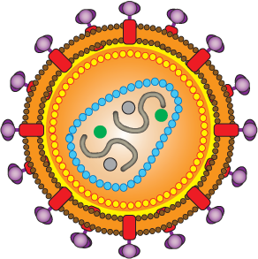
HIV cure research
ART controls HIV replication in the blood and other compartments (genital tract, breast milk)
When a person is started on ART, the viral load decreases to “undetectable” (<50 viral copies/mL of blood) within 2-6 months
start
ART
ART

Slide 12
HIV cure
ART
But ART does not get rid of the HIV virus – if ART is stopped, the viral load climbs up again
This is because even with ART, the virus remains integrated into the DNA in certain kinds of CD4 cells, capable of producing more HIV viruses if ART is not used

Slide 13
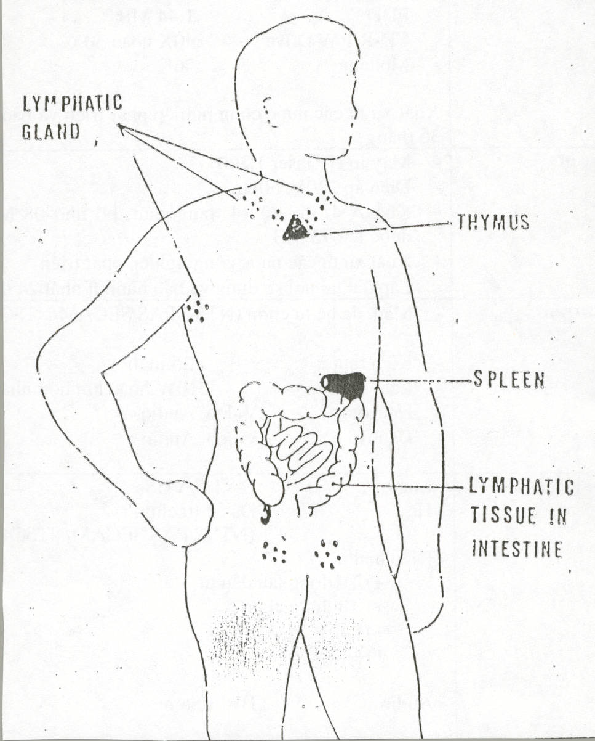
HIV reservoirs
The kinds of cells where HIV hides and remains “latent” in the body are called “viral reservoirs” – long-lived cells with HIV integrated into their DNA, which can become activated many years later to produce more HIV virus
Certain tissues -> gut lymphoid tissue, lymph nodes, spleen, thymus; small numbers in blood
Researchers have long believed that if they can target and remove these reservoirs, then HIV can be cured

Slide 14
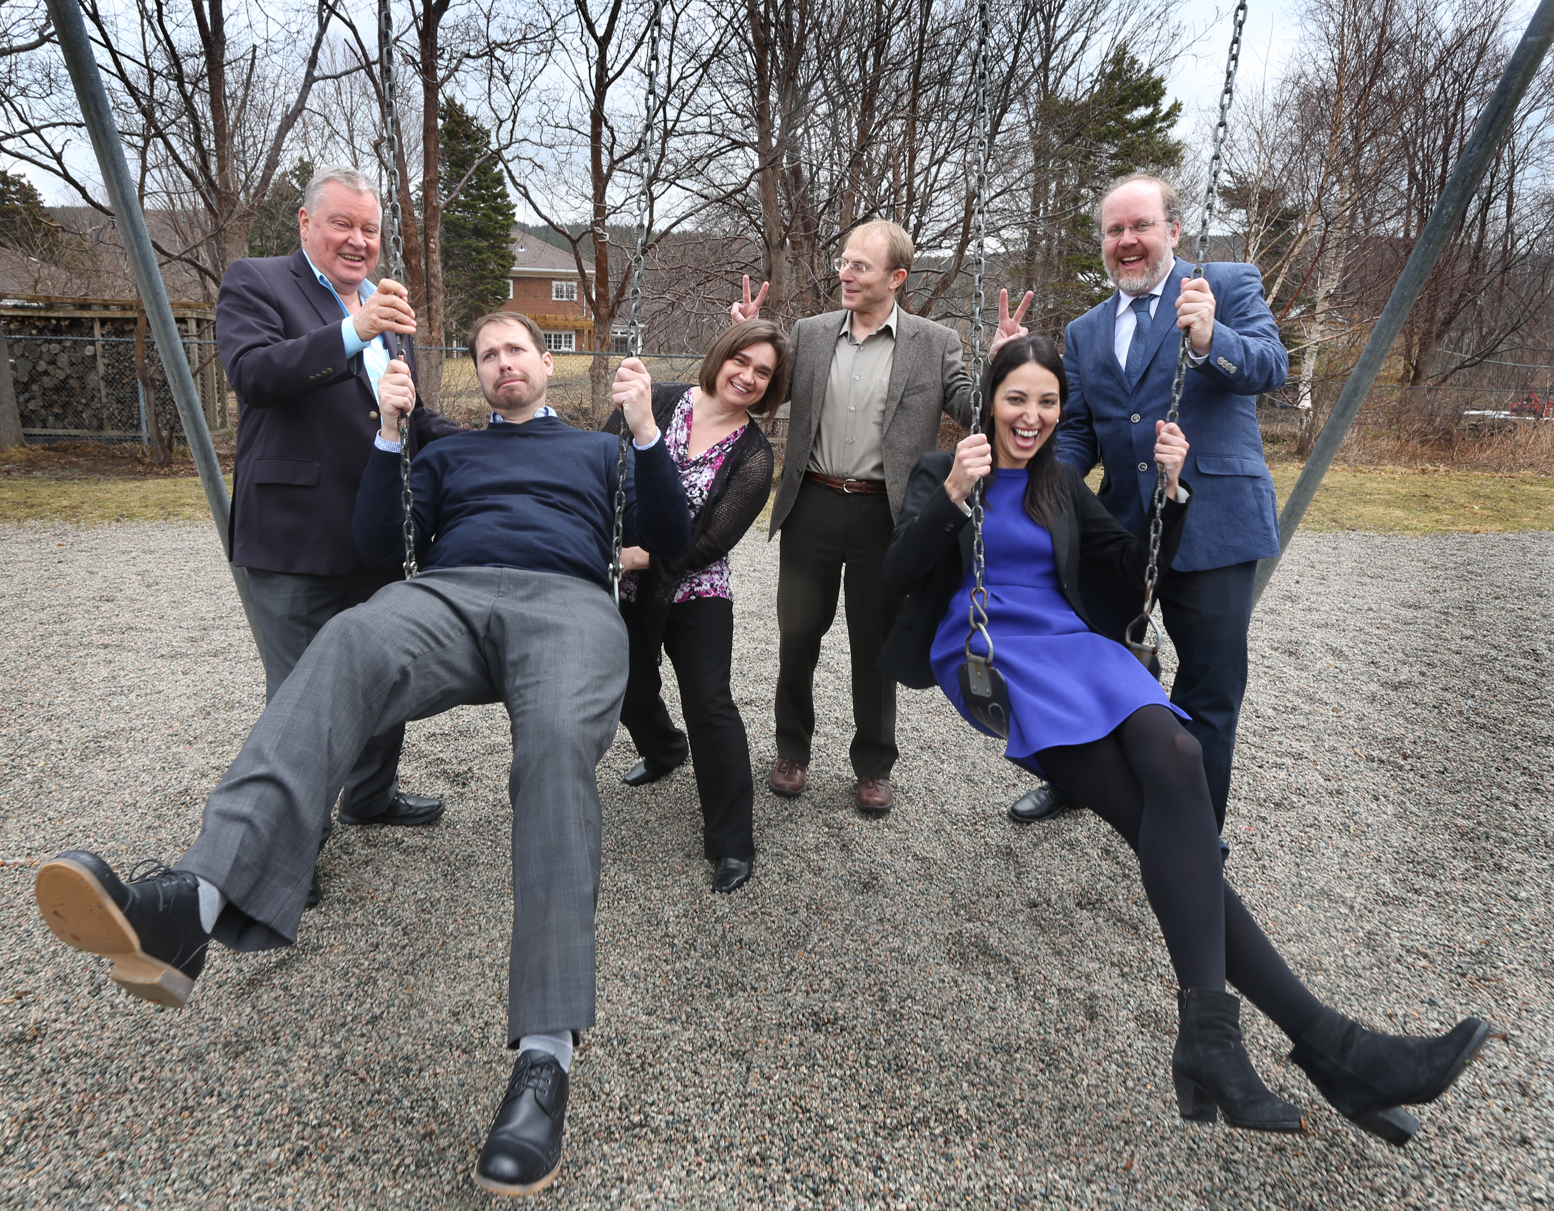
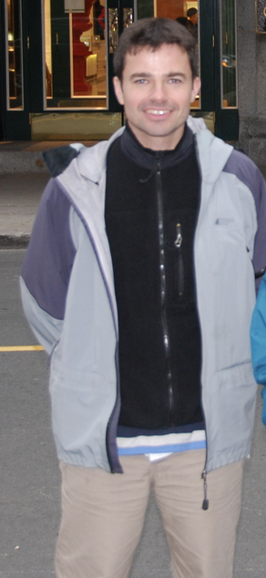
Early Pediatric Treatment Initiation – Canada Child CURE Cohort study Dr. Fatima Kakkar
This project is enrolling HIV+ children, born with the infection, to determine how early treatment of HIV may affect the creation of HIV reservoirs and the possibility for cure of HIV in the future
Led by Dr. Hugo Soudeyns, a lab researcher from Ste-Justine in Montreal

Slide 15
https://epic4.ca
PROJECT 1. Does early (immediate) treatment after birth limit the size of viral reservoirs in children living with HIV from birth?
PROJECT 2. Does early (immediate) treatment after birth affect how the immune system handles the HIV infection in children living with HIV from birth?

Slide 16
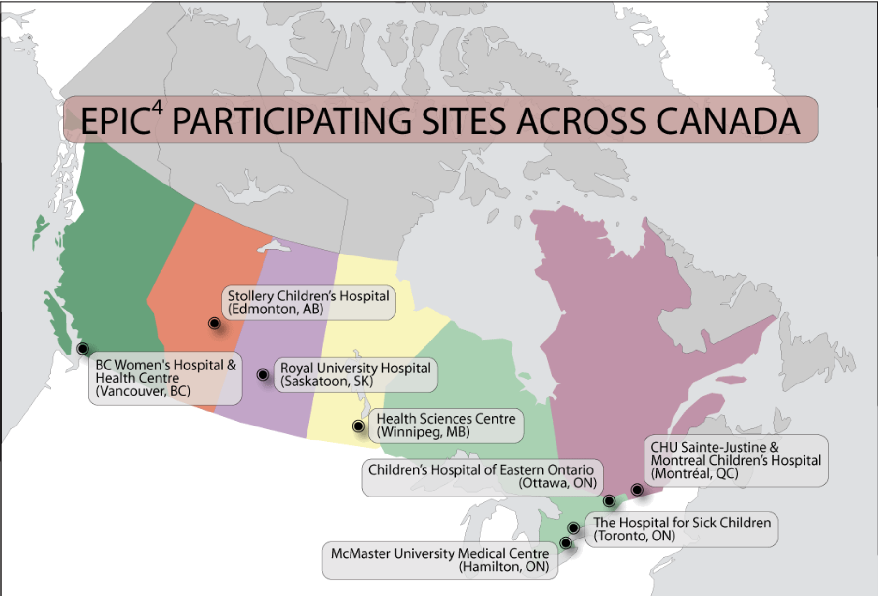
https://epic4.ca
We are enrolling children at 7 pediatric sites across the country:
-Montreal (2)
Ste-Justine – Dr. Kakkar
Montreal Children’s – Dr. Karatzios
-Ottawa
CHEO – Drs. Samson/Brophy
-Toronto
SickKids – Drs. Bitnun/Read
-Hamilton
McMaster – Dr. Seigel
-Saskatoon
Royal University – Dr. Tan
-Edmonton
Stollery Children’s – Drs. Vaudry/Hawkes
-Vancouver
Oak Tree Clinic – Drs. Alimenti/Sauvé

Slide 17
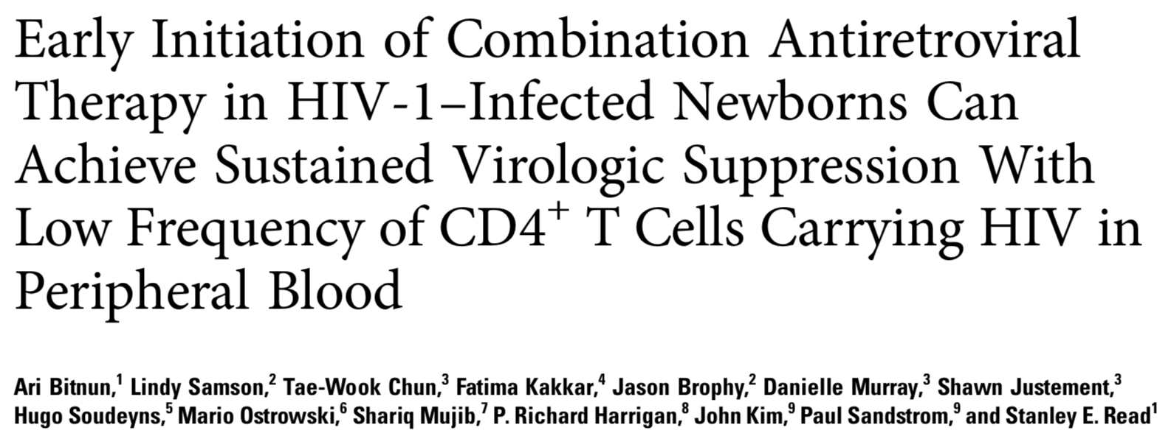
What have we discovered so far?
4 children who started treatment in first 48 hours of life had extremely low reservoirs – no virus or almost no virus (1 virus in 10 million cells), no HIV antibody production. 3/4 had genes associated with ability to control HIV well.
Bitnun et al, Clin Infect Dis 2014

Slide 18
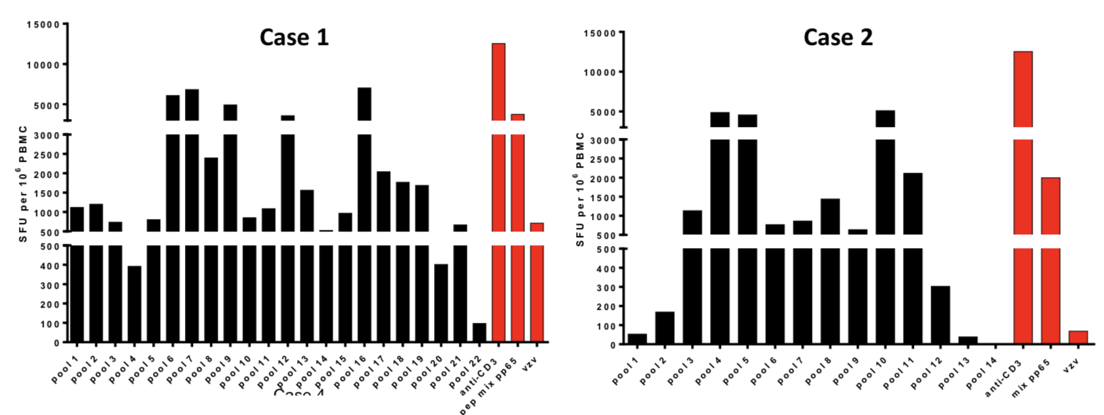
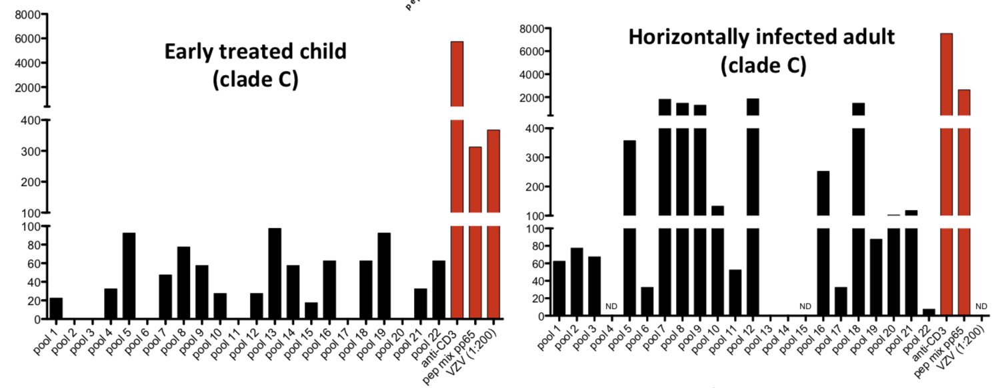
Two adolescent girls who controlled HIV without treatment
Case 1 – never started treatment, almost always undetectable viral load with normal CD4 cells
Case 2 – was on treatment for 10 years, stopped (without telling doctor) but viral load remained undetectable for >5 years
Both had VERY STRONG immune system responses to HIV – suggests that something about their immune systems was different, allowed them to control HIV

Slide 19
EPIC4 at CAHR 2018
HIV reservoir size in peripheral blood of perinatally infected children: Results from the EPIC4 (Early Pediatric Initiation, Canada Child Cure Cohort) study (A. Bitnun)
Among 52 children with at least 3 years of suppressed viral loads (12 start at <6mo; 18 started >6mo; 22 only after 2nd ART combination) - earlier treatment and earlier HIV suppression were associated with smaller reservoirs measured in multiple ways
Challenges to achieving and maintaining sustained viral suppression among HIV infected Canadian children
(F. Kakkar)
Among 211 children in EPIC4 cohort, only 44% got to an undetectable viral load with treatment. Predictors for undetectable VL were higher economic status, stable family environment (), and being an immigrant.

Slide 20
EPIC4 at CAHR 2018
Microbial translocation, inflammation and endothelial activation in vertically HIV-1 infected children
(M. Hawkes)
In a previous EPIC4 study, some children still had markers of blood vessel inflammation despite having undetectable viral load. Longer treatment and starting treatment at a younger age were related to lower vessel inflammation. In this study, among 97 children with current undetectable VL, levels of overall inflammation, blood vessel inflammation and gut inflammation were all related to each other. This suggests earlier treatment has the potential to better reduce these levels of inflammation in children, which can last years after starting ART.

Slide 21
EPIC4 Summary
Earlier treatment of children (eg. as soon as possible in infancy) has the potential to limit the bad long term effects of HIV. With newer, better treatments, this is easier to do than in the past.
Maintaining a lower viral reservoir may help in the future when we have options for treatments for cure (drugs to get rid of reservoirs, vaccines to improve control of virus)
Hopefully, we can get another 5 years of funding for a second phase of EPIC4 – grant competition in October 2018 – fingers crossed!

Slide 22
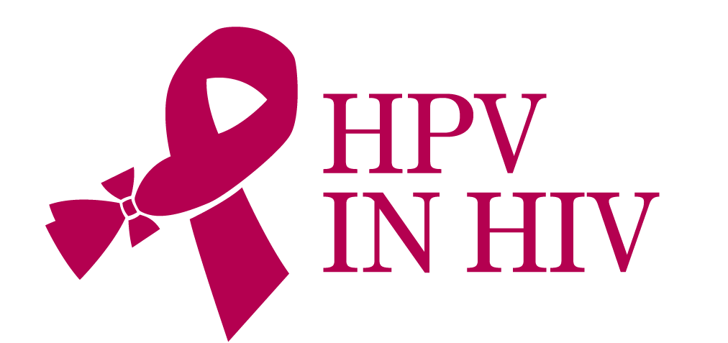
HPV Vaccine in HIV+ Girls & Women Study Nancy Lipsky/Dr. Deborah Money
HPV in HIV Co-investigator Team:
Ari Bitnun Sandra Blitz
Jason Brophy Francois Coutlee
Jan Christilaw Simon Dobson
Chris Karatzios Marina Klein
Mel Krajden Normand Lapointe
Mona Loufty Jessica McAlpine
Gina Ogilvie Janet Raboud
Lindy Samson Joel Singer
Fiona Smaill Sylvie Trottier
Sharon Walmsley Wendy Wobeser
Ariane Albert Elisabeth McClymont
Mark Yudin

Slide 23
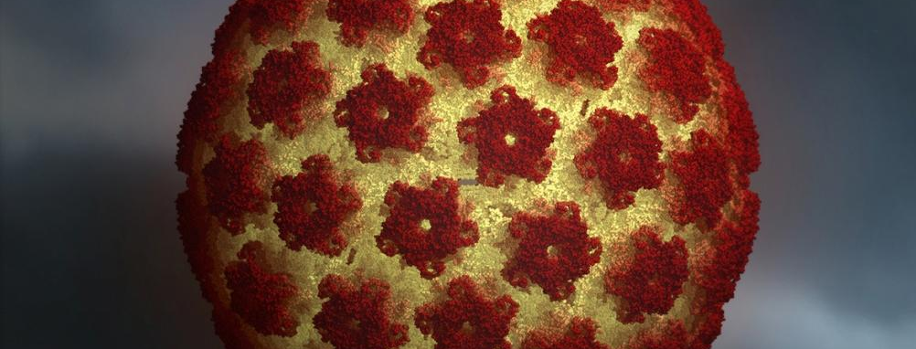
What is HPV? Human Papillomavirus
The human papillomavirus under a microscope

Slide 24
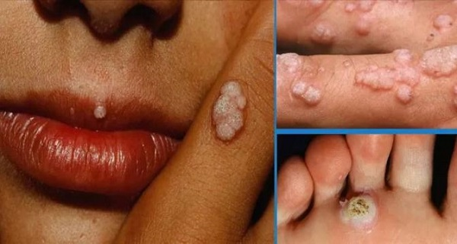
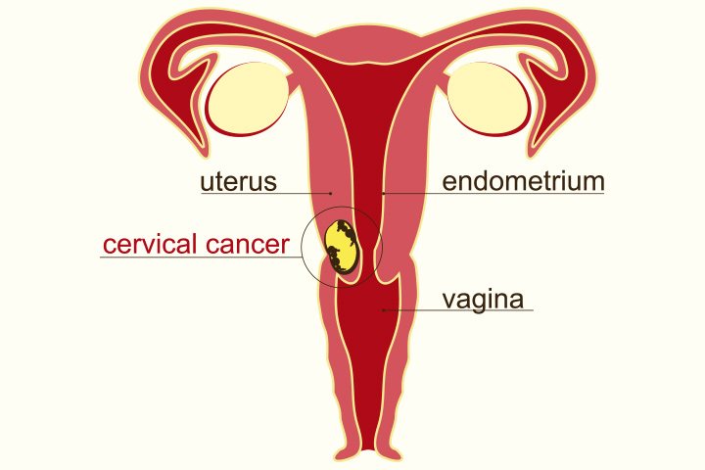
What is HPV? Human Papillomavirus
Note: The vast majority of HPV infections reverse on their own without clinical symptoms.

Slide 25
DID YOU KNOW?
75% Of Canadians
will get HPV,
which means
for every group
of 4 people,
3 of them have
HPV!
Use of condoms helps prevent the spread of HPV!

Slide 26
HPV in Women with HIV
Women with HIV have two times higher rates of HPV infection compared to women without HIV
Different types of HPV seen in women with HIV
Women with HIV more likely to have persistent HPV infection and at greater risk for cervical cancer
THIS IS WHY IT’S SO IMPORTANT TO TRY TO PREVENT HPV IN GIRLS & WOMEN WITH HIV !!!
Notes:
“Studies have shown that more than 90 percent of new HPV infections, including those with high-risk types, clear or become undetectable within two years, and clearance usually occurs in the first six months after infection,

Slide 27
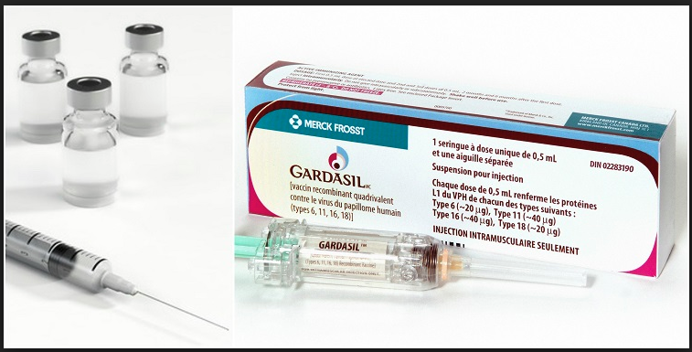
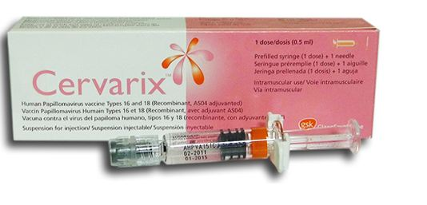
HPV Vaccines
Not live virus vaccines, safe in people with weak immune systems
Cervarix – protects against 2 types of HPV (16 +18 – cancer types)
Gardasil – 2 versions
Original Gardasil – protected against 4 types of HPV (16+18, also 6+11 – wart types)
Gardasil-9 protects against 9 types of HPV (6, 11, 16, 18, + 5 more cancer types – 31, 33, 45, 52, 58)
Notes:
HPV vaccines are approved for use in over 100 countries, with more than 100 million doses distributed worldwide. Extensive clinical trial and post-marketing safety surveillance data indicate that both Gardasil and Cervarix are well tolerated and safe.^{[50]}
A cohort study of approximately 1 million girls found no evidence supporting associations between exposure to quadrivalent human papillomavirus vaccine and autoimmune, neurological, and venous thromboembolic adverse events.^{[51]}
Statistical power was sufficient to conclude that qHPV vaccine effectiveness remains above 90% for at least 10 years.

Slide 28
HPV Vaccination in HIV Study
Lead by Dr. Deborah Money (Vancouver) with 14 HIV clinics across Canada (including 5 pediatric HIV clinics)
The study asked “how well does the Gardasil (4-types) vaccine work for HIV+ girls & women?”
Included girls >9 years and women living with HIV

Slide 29
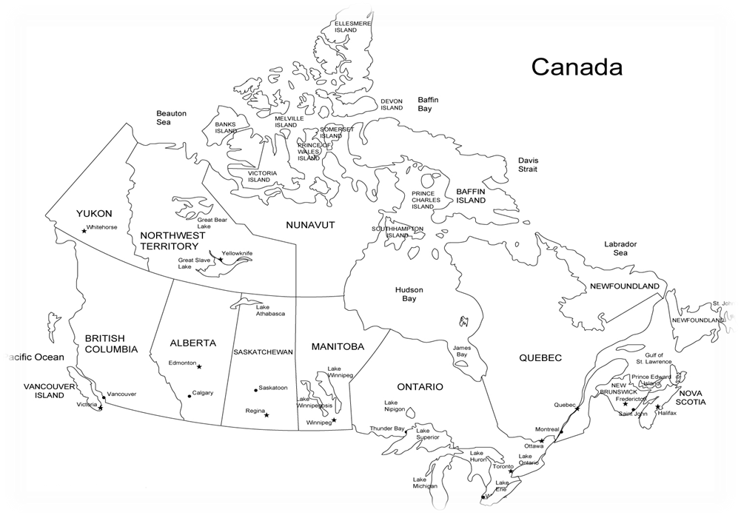
HPV Study Clinical Sites
St. Michael’s Hospital
Hôpital CHUL/CHUQ
The Hospital for Sick Children
Oak Tree Clinic
Hotel Dieu Hospital
Toronto General Hospital
Montreal Chest Institute
St. Paul’s Hospital
Maple Leaf Medical Clinic
Quebec
CHU
Sainte-Justine
Montreal
HIV Care Program
Ottawa
Montreal Children’s Hospital
Hamilton Health Sciences
Toronto
CHEO

Slide 30
310 women >15 years enrolled, 277 received full 3-dose series
The vaccine produced a response against the 4 HPV types in 94-99% of women
Having an undetectable VL lead to 2-3x higher immune (antibody) responses compared to those with detectable VL

Slide 31
35 girls aged 9-14 years enrolled, 32 received full 3-dose series
The vaccine produced a response against the 4 HPV types in 100% of girls
But the levels of antibody they produced were much lower than HIV-negative girls (50%-70% lower)
Having an undetectable VL lead to 2-6x higher immune (antibody) responses compared to those with detectable VL
After 24 months, ~20% of girls had lost their immune response to HPV types (almost 100% of HIV-negative girls keep their response at 24 months)

Slide 32
REsults
In both studies, the vaccine was safe and well tolerated. Lower rates of side effects were seen in HIV+ girls compared to HIV-negative girls in other studies.

Slide 33
Next steps for hpv study
First 5-year study followed girls and women for 24 months after vaccination, and looked at antibody levels only
Second 5-year study is continuing to follow those girls and women to see:
how long their antibodies last
if the vaccine protects from catching HPV and developing cervical cancer
if they need a booster dose of vaccine

Slide 34
Children & Woman, AntiRetroviral therapy and the MARKERs of Aging (CARMA) Dr. Jason Brophy
The CARMA team has been working together for 10 years
CARMA focuses on how exposure to HIV and antiretroviral drugs may cause problems leading to early aging in HIV+ women and their children (both HIV+ and HIV-exposed but uninfected)

Slide 35
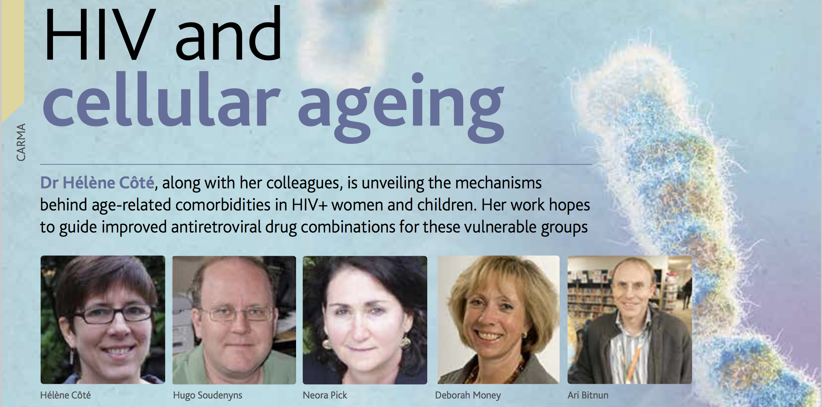
HIV in pregnancy & aging – the CARMA study
Lead by Dr. Hélène Côté, a lab researcher in Vancouver
Many team members include adult and pediatric HIV physicians, obstetricians, bone experts, and other researchers
5 clinics participating: Vancouver, Toronto, Ottawa, and Montreal

Slide 36
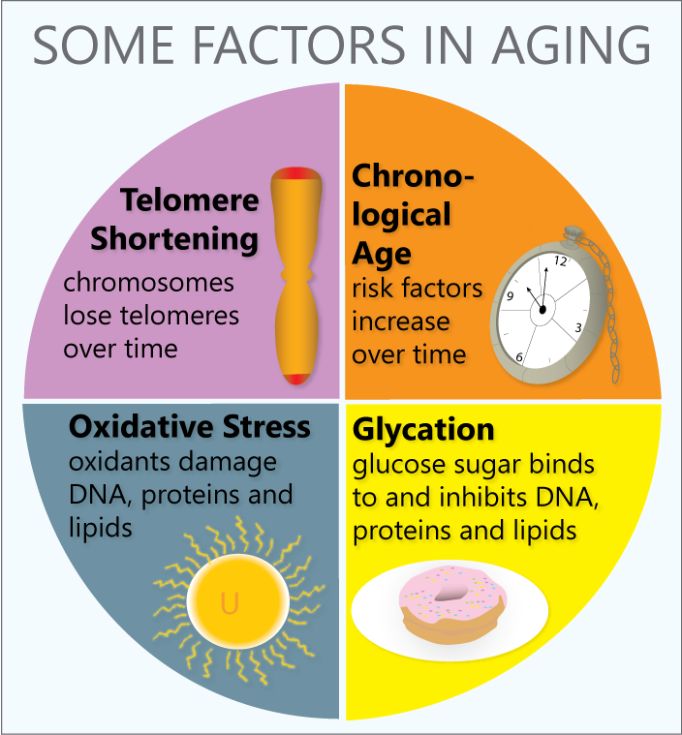

Slide 37
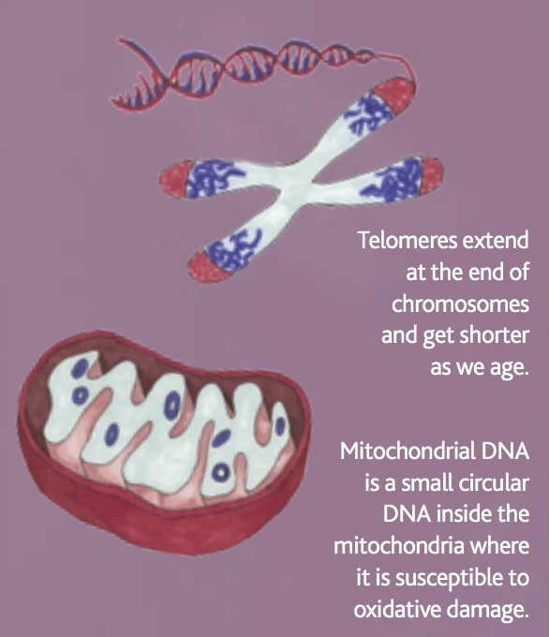
CARMA looks at the effects of HIV & Arvs on Mitochondria and telomeres

Slide 38
HIV/ARV effects on mitochondria

Slide 39
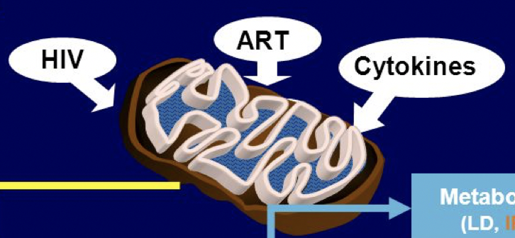
HIV/ARV effects on mitochondria
Mitochondria have an enzyme that helps them multiply.
This enzyme is called DNA polymerase gamma, which is similar to the HIV enzyme called reverse transcriptase (RT).
Two families of ARVs (NRTIs and NNRTIs work to suppress HIV by inhibiting HIV RT enzyme, but NRTIs can also inhibit the mitochondrial polymerase gamma.
When this happens, fewer new mitochondria may be produced or mitochondria may not function normally (“mitochondrial dysfunction”).
NRTI drugs:
-zidovudine
(AZT - Combivir)
-lamivudine
(3TC – Combivir, Kivexa)
-stavudine
(d4T - Zerit)
-didanosine
(ddI - Videx)
-abacavir
(ABC - Kivexa)
-tenofovir
(TDF - Truvada)

Slide 40
HIV/ARV effects on mitochondria
BUT – mitochondria may also be affected by other things – HIV itself, inflammation caused by HIV or infections, or other drugs/exposures

Slide 41
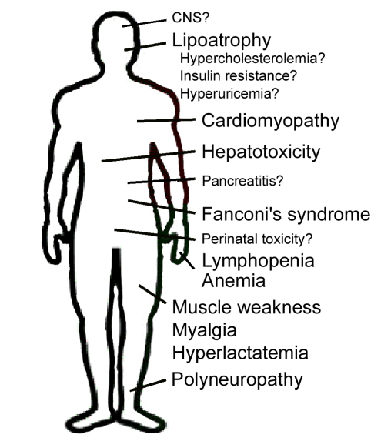
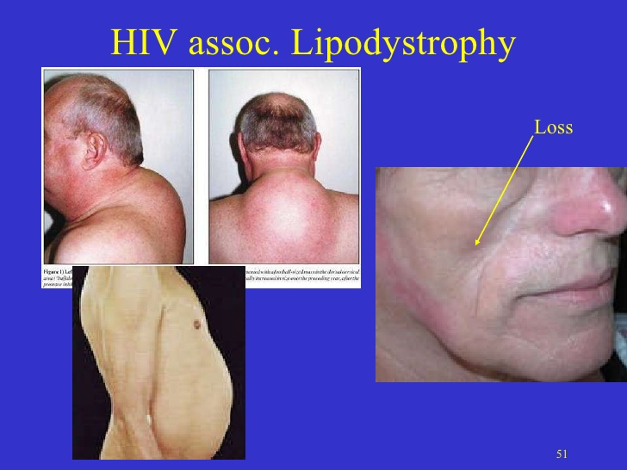
HIV/ARV effects on mitochondria
There are many ways in which HIV and/or ARVs are theorized to affect mitochondria and cause problems in patients living with HIV
Brain (“encephalopathy”)
Fat gain or loss (“lipodystrophy”)
↑Cholesterol & Triglycerides
Diabetes
Heart
Liver (fatty liver)
Pancreas (pancreatitis)
Kidneys
Pregnancy and fetal
development
Muscle weakness
Muscle aches
Increased acid (“lactic acidosis”)
Nerves (“peripheral neuropathy”)

Slide 42
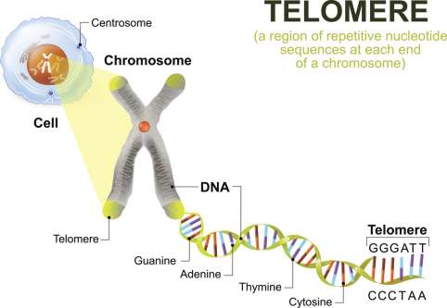
Telomeres & TElomerase
Telomeres are found at the tips of chromosomes
Every time a cell divides it duplicates all its chromosomes, and there is a loss of some of the telomeres. Over time, more and more of the telomere is lost and when too much is lost, the cell dies (old age)
Telomerase is an enzyme that helps repair the loss of the telomeres – it is what helps to fight aging

Slide 43
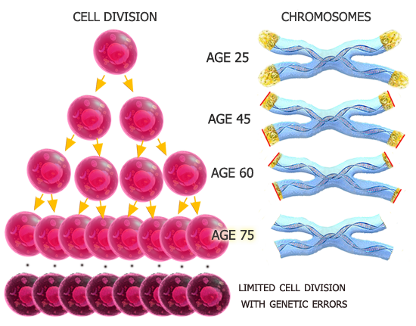
HIV/ARV effects on Telomeres
NRTI drugs can also inhibit the telomerase enzyme
If telomerase is inhibited or not working well, then it may contribute to decreased ability to replicate DNA and lead to early aging through cell death

Slide 44
CARMA Study – # of participants
HIV+ women | HIV- women | HIV+ pediatric | HEU pediatric | Control children
N=265 | N=257 | Vancouver N=56 Ottawa N= 18 Montreal N=57 TOTAL N=131 | Vancouver N=58 Ottawa N =65 Montreal N = 156 TOTAL N=279 | ?

Slide 45
CARMA Study Results – Telomeres
Telomere length in children was NOT associated with exposure to mother’s HIV/ARVs, or with being HIV+
Telomere length WAS decreased over time in children with uncontrolled HIV
Cote et al, PLOS One 2012

Slide 46
CARMA Study Results – Telomeres
Telomere length in children was NOT associated with exposure to mother’s HIV/ARVs, no different that HIV unexposed children
Ajaykumar et al, J Infect Dis 2018

Slide 47
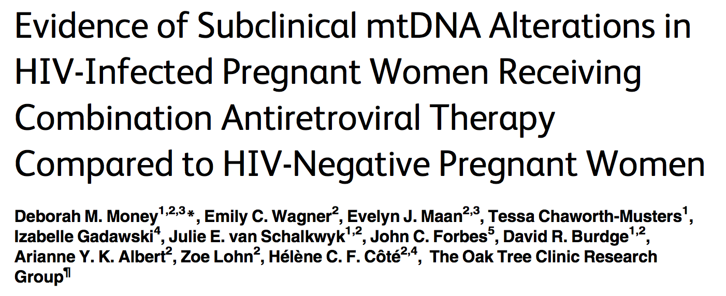
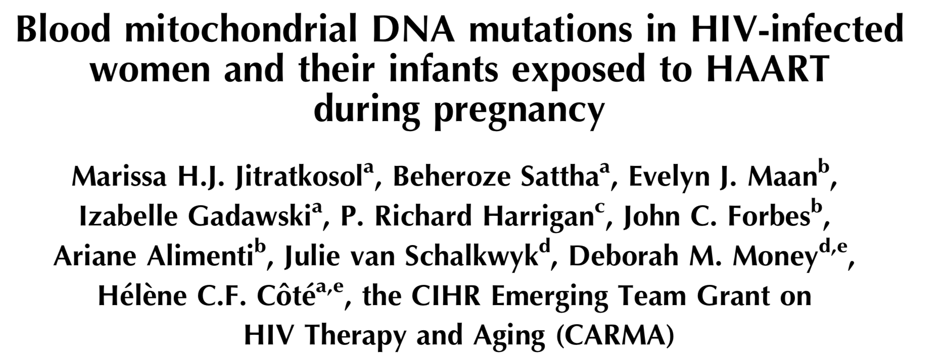
CARMA Study results – Mitochondria
Mitochondrial changes in mother’s and baby’s blood related to HIV+ARV exposure

Slide 48
Mitochondria
Why worry about mitochondrial damage?
Certain parts of the body are richer in mitochondria – the parts of the body that require lots of energy:
Brain
Heart
Liver

Slide 50
Mitochondria & Autism
The cause of autism isn’t well understood, but at least some cases of autism (~5-6%) are related to mitochondrial dysfunction

Slide 51
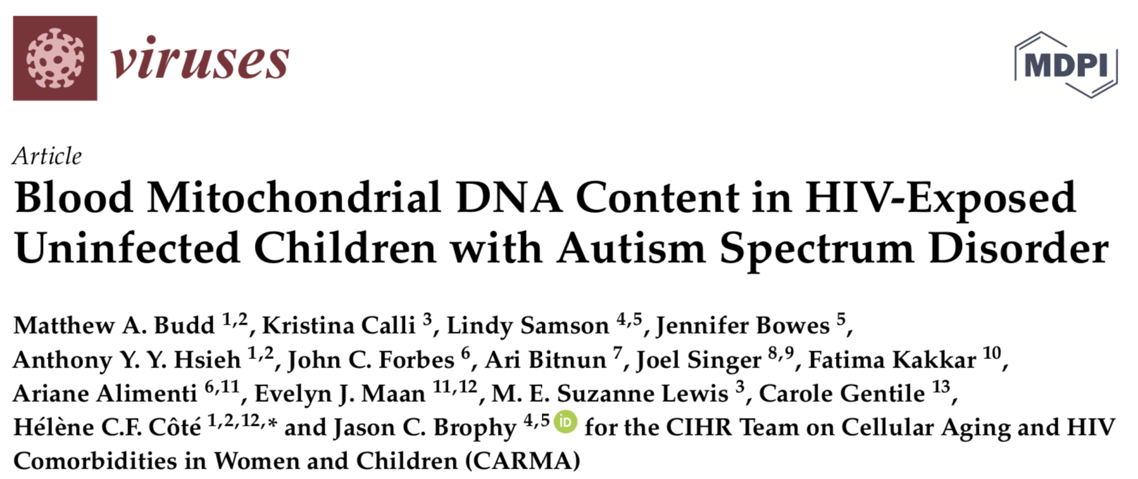
Group | CARMA Autism+HEU (n=16) | CARMA No Autism HEU (n=48) | CARMA Control HUU (n=48) | ASPIRE Autism, no HEU (n=48) | ASPIRE Control HUU (n=10)
Sex | 11M, 5F | 33M, 15F | 33M, 15F | 33M, 15F | 6M, 4F
Ethnicity | 12 Black, 4 White | 36 Black, 12 White | Unknown | 5 Black, 24 White, 5 Asian, 3 South Asian, 2 Aboriginal, 9 Other/Mixed | 1 Black, 5 White, 2 Asian, 2 South Asian
Age (mean ± SD) [range] | 6.6 ± 3.6 [2.3 to 15.7] | 6.4 ± 3.2 [2.2 to 15.6] | 6.6 ± 3.5 [2.2 to 15.7] | 6.6 ± 3.5 [2.4 to 15.9] | 7.6 ± 4.3 [3.0 to 15.0]
Visit site | 13 Ottawa 2 Toronto 1 Montreal | 15 Ottawa 33 Montreal | 48 Vancouver | 48 Vancouver | 10 Vancouver

Slide 52
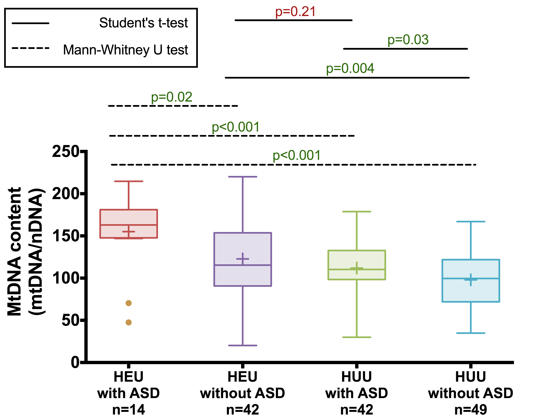
REsults
Highest amount of mitochondrial damage in HIV-exposed with autism (16 kids)
Similar amount of mitochondrial damage in HIV-exposed without autism (48 kids), and autism without HIV exposure (48).
Children with neither autism nor HIV-exposure (58) were lowest

Slide 53
Mitochondria & Autism
It is not clear what is causing the increased mitochondrial damage in the HEU children with autism
HIV+ mothers of kids with autism started ARVs later in pregnancy – is it exposure to more HIV in pregnancy – more inflammation during the baby’s development?
No association between any specific ARV and autism risk
Maybe there was a genetic risk for autism, and when HIV or ARV exposure was added it increased the chance of the child having autism

Slide 54
CARMA future directions
We are interested in understanding how the changes in treatment of women in pregnancy might affect mitochondria and telomeres in their children:
Everyone recommended to start ARVs right away – this means that more women will become pregnant already on treatment (in the past, if woman was well with good CD4 count, she would only start treatment when in 2nd trimester of pregnancy)
Drugs used in pregnancy have changed:
1990s-early 2000s – zidovudine, stavudine, lopinavir, nevirapine
mid-2000s-early 2010s – tenofovir, abacavir, atazanavir
Past 5 years – darunavir, raltegravir, elvitegravir

Slide 55
SUMMARY OF STUDIES
In all of these studies, one thing was clear: the HIV+ people who were on ART earlier with suppressed viral loads did better:
HIV+ children had lower viral reservoirs and lower inflammation
HIV+ girls had better HPV vaccine responses
HIV+ women and children had less mitochondrial damage
Children with autism were more likely to have had HIV+ mothers who were not on treatment for longer during pregnancy
Need to keep doing research on the best treatments with the fewest side effects

Slide 56
QUESTIONS & DISCUSSION
BIG THANK YOU TO OUR EVENT SPONSORS:
THANK YOU FOR YOUR ATTENTION!

Slide 57
Biggest Thank you of all!!!!!!
To all of the children/teens and parents who participated in these CPARG studies.
Without their time and participation and samples, none of this research would be possible.
We hope that the lessons learned will improve patient care and advance knowledge about pediatric HIV – and that someday we will find a cure!!!

